Slide 1

Java and its Evolution

Slide 2
Contents
Java Introduction
Java Features
How Java Differs from other OO languages
Java and the World Wide Web
Java Environment
Build your first Java Program
Summary and Reference

Slide 3
Java - An Introduction
Java - The new programming language developed by Sun Microsystems in 1991.
Originally called Oak by James Gosling, one of the inventors of the Java Language.
Java Authors: James , Arthur Van , and others
Java is really “C++ -- ++ “

Slide 4
Java Introduction
Originally created for consumer electronics (TV, VCR, Freeze, Washing Machine, Mobile Phone).
Java - CPU Independent language
Internet and Web was just emerging, so Sun turned it into a language of Internet Programming.
It allows you to publish a webpage with Java code in it.

Slide 5
Java Attributes
Familiar, Simple, Small
Compiled and Interpreted
Platform-Independent and Portable
Object-Oriented
Robust and Secure
Distributed
Multithreaded and Interactive
High Performance
Dynamic and Extensible

Slide 6
Java is Compiled and Interpreted
Programmer
Hardware and
Operating System
Source Code
Byte Code
Text Editor
Compiler
Interpreter
.java file
.class file
Notepad, emacs,vi
javac
java
appletviewer
netscape

Slide 7
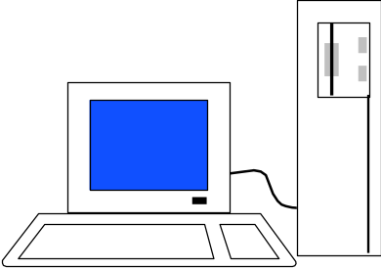
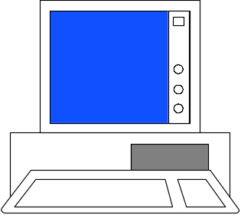
Total Platform Independence
JAVA COMPILER
(translator)
JAVA BYTE CODE
(same for all platforms)
JAVA INTERPRETER
(one for each different system)
Windows 95
Macintosh
Solaris
Windows NT

Slide 8
Architecture Neutral & Portable
Java Compiler - Java source code (file with extension .java) to bytecode (file with extension .class)
Bytecode - an intermediate form, closer to machine representation
A interpreter (virtual machine) on any target platform interprets the bytecode.

Slide 9
How Does Java Compares to C++ and Other OO Languages

Slide 10
Overlap of C, C++, and Java
C++
C
Java

Slide 11
Java better than C++ ?
No Typedefs, Defines, or Preprocessor
No Global Variables
No Goto statements
No Pointers
No Unsafe Structures
No Multiple Inheritance
No Operator Overloading
No Fragile Data Types
?

Slide 12
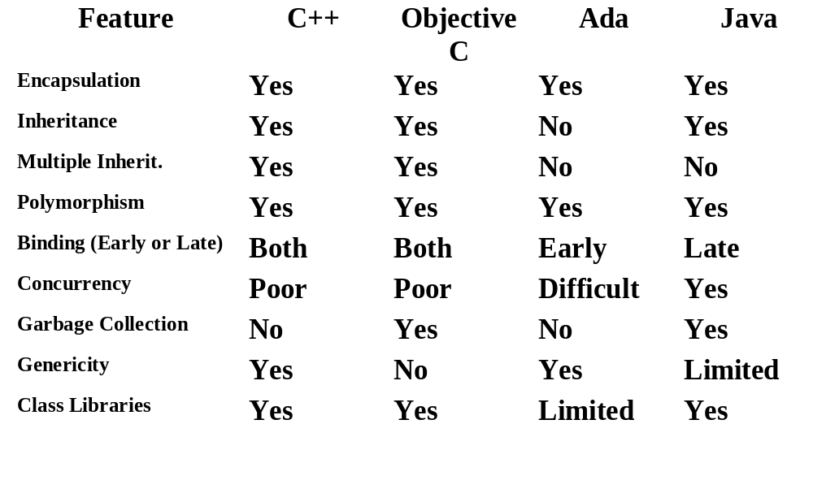
Object Oriented Languages -A Comparison

Slide 13
Java Integrates
Power of Compiled Languages
and
Flexibility of Interpreted Languages

Slide 14
Java Applications
We can develop two types of Java programs:
  Stand-alone applications
  Web applications (applets)

Slide 15
Applications v/s Applets
Different ways to run a Java executable are:
  Application- A stand-alone program that can be invoked from command line . A program that has a “main” method
  Applet- A program embedded in a web page , to be run when the page is browsed . A program that contains no “main” method

Slide 16
Applets v/s Applications
Different ways to run a Java executable are
  Application- A stand-alone program that can be invoked from command line . A program that has a “main” method
  Applet- A program embedded in a web page , to be run when the page is browsed . A program that contains no “main” method
Application –Executed by the Java interpreter.
Applet- Java enabled web browser.

Slide 17
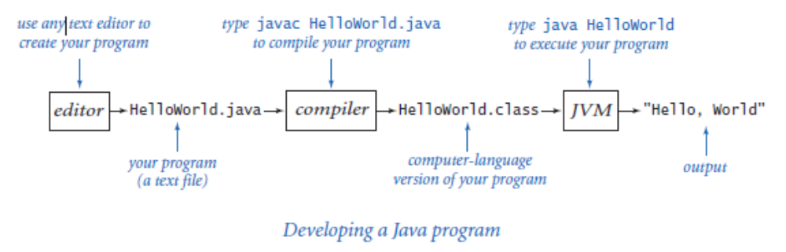
Process of Building and Running Java Programs

Slide 18
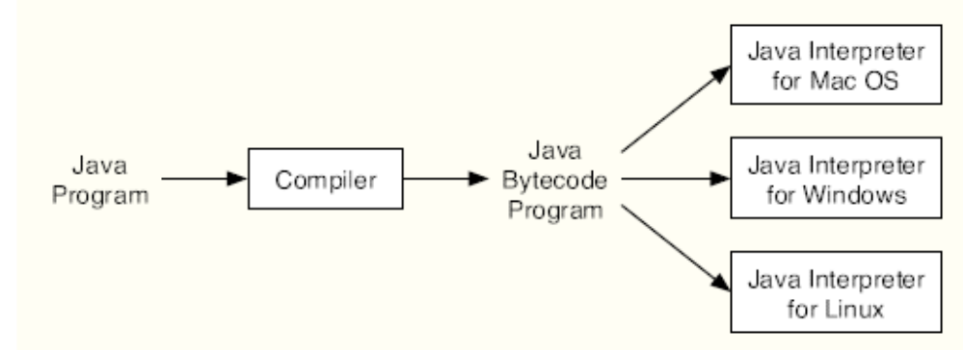
Java Virtual Machine (JVM)
The designers of Java chose to use a combination of compilation and interpretation. Pro-grams written in Java are compiled into machine language, but it is a machine language for a computer that doesn’t really exist. This so-called “virtual” computer is known as the Java
virtual machine

Slide 19
Let us Try Out
Building your first Java Program

Slide 20
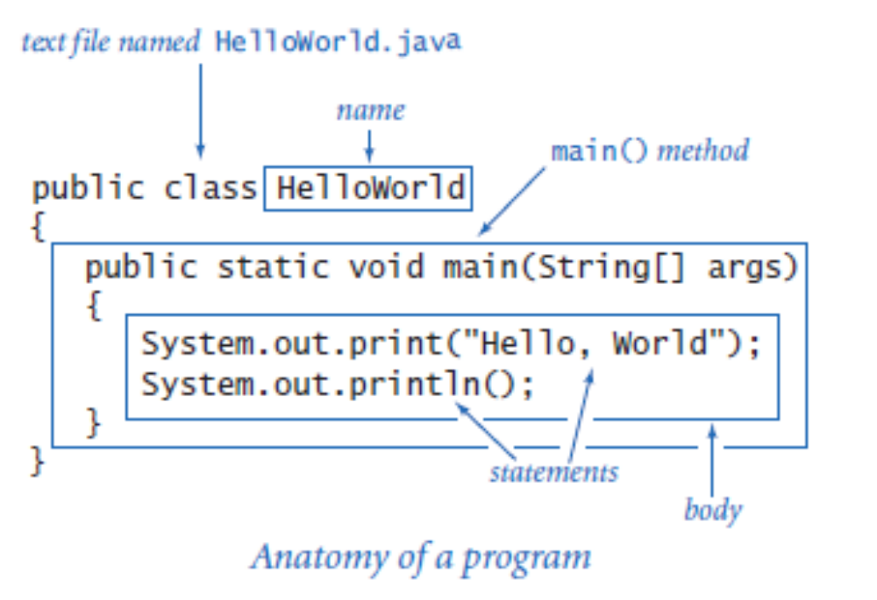
Building Your First Program

Slide 21
Simple Java Applet
//HelloWorld.java
import java.applet.Applet;
import java.awt.*;
public class HelloWorld extends Applet {
  public void paint(Graphics g) {
  g.drawString (“Hello World !”,25, 25);
  }
}

Slide 22
Calling an Applet
<HTML>
<TITLE>HELLO WORLD APPLET</TITLE>
<HEAD>THE HELLO WORLD APPLET</HEAD>
<APPLET CODE=“HelloWorld.class” width=500 height=500>
</APPLET>
</HTML>

Slide 23
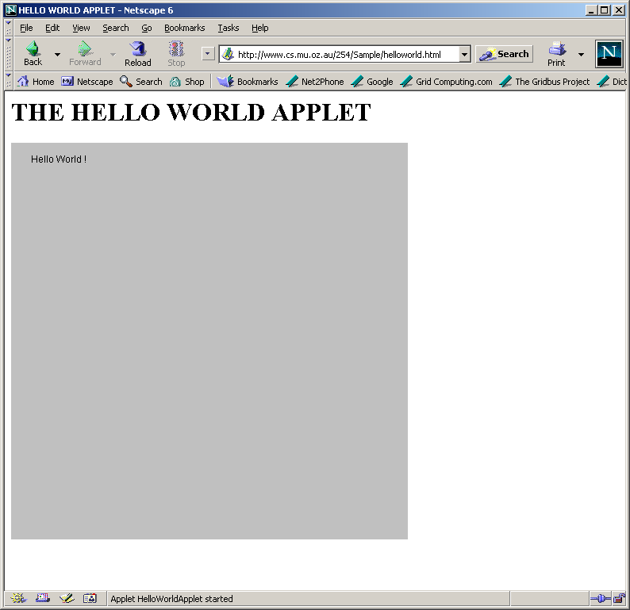
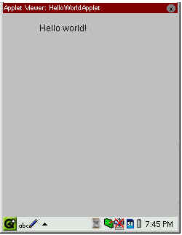
Applet Execution
Using AppletViewer
Using Browser

Slide 24
Summary
Java has emerged as a general purpose OO language.
It supports both stand alone and Internet Applications.
Makes the Web Interactive and medium for application delivery.
Provides an excellent set of Tools for Application Development.
Java is ubiquitous!

